Slide 1
Choose Your Job Board
Best practices for using LinkedIn, Indeed and Government job boards to look for a co-op job
Summer 2025

Slide 2

Current Job Market Insights
The job market is not ideal right now:
Economy is weak; market uncertainty (tariffs)
Government informal freeze of jobs (now at 10%), an all-time low
Many private sector (high tech) employers work comes from either federal or US government
Competition with other colleges and universities has never been higher
Job searching is competitive!
Notes:
Insights from our Industry Engagement Specialist team

Slide 3
Current Job Market Insights
What do we expect from students?
Don’t apply late! Tardiness applying to jobs will be catastrophic in job search (that time will not come back, nor will the jobs)
Students must be open-minded and persistent when looking
Expect to see jobs from all over the province/country
Expect more direct apply jobs (all Post Secondary Institutions are seeing this trend)
Students must be prepared to travel should they wish to secure co-op employment
Co-op is not the place for a student to find their "dream job". It's a foot in the door.
Expect entry level jobs, not management level (pad your resume, develop a network)
Notes:
Insights from our Industry Engagement Specialist team

Slide 4
Major Job Boards in Canada
LinkedIn
Job Bank
City of Ottawa
Indeed
FSWEP
Ontario Public Service Careers

Slide 5
Online Job Board Best Practices
Customize your resume and cover letter to each position.
Identify the Essential vs. Non-Essential job duties.
Apply to jobs where you meet at least 80% of qualifications. Your education years can often count as years of experience.
Avoid using templates to overcome Applicant Tracking Systems (ATS).
Search for jobs using a variety of key words and different titles.
Don’t wait until the closing date to apply.
Notes:
Overlap with ‘Job Search Outside HireAC’ job search term workshop

Slide 6
LinkedIn Best Practices
Notes:
Overlap with ‘Job Search Outside HireAC’ job search term workshop

Slide 7

LinkedIn as a Job Search Tool
Create an all-star profile to increase visibility
Follow companies and join groups related to your industry or career aspirations to receive regular updates on job postings and recruitment events
Utilize the Jobs features to receive tailored job suggestions in your industry
Add the #Opentowork filter on your profile picture to let all LinkedIn members know you’re looking
Create job alerts
Notes:
Recommendations

Slide 8
LinkedIn & Job Search
The Jobs feature suggests jobs you may be interested in based on your profile and companies/positions you have viewed
Optimize your job search and apply using the LinkedIn Easy Apply button
Let recruiters known you’re open – turn on Open to Work
Get surfaced in recruiter searches that match your career interests
Double your chances of receiving relevant messages
Allows you to type a message to recruiters and identify what types of jobs you are interested in

Slide 9
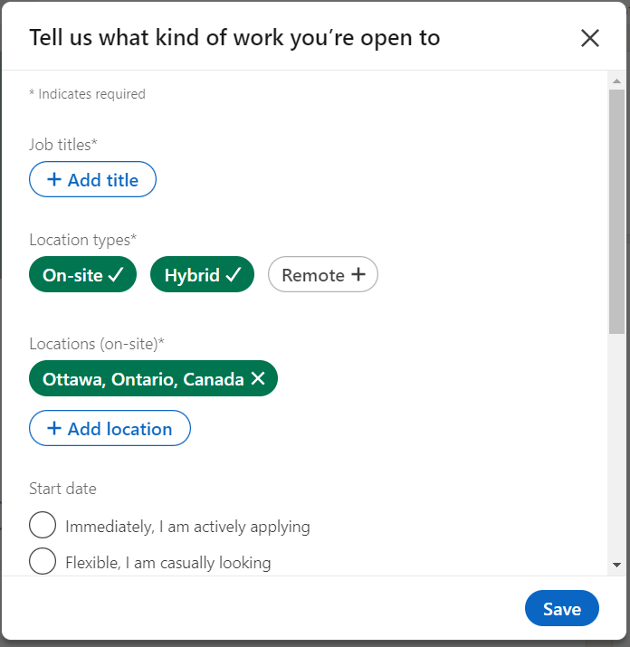

Slide 10
LinkedIn & Networking
Network with your connections for job leads
Make meaningful connections – this can include professionals, classmates, or recruiters who work for companies you are interested in!
Use search terms like ‘recruiter – [Company name] – [job title]’
Ensure you send a custom message to your new connection and say how you know each other or how you intend develop the relationship
Keep an eye out for “2nd” connections

Slide 11
Indeed Best Practices

Slide 12
Search Parameters
Use Boolean search terms to get more precise results
Example: “student AND co-op AND internship”
Try a variety of titles
Example: “Career advisor / recruiter / employment consultant”
Filter results by ‘Date Posted’ to view more recent postings first
Look for tags like ‘Responsive Employer’, ‘Sponsored job’ or ‘Hiring multiple candidates’

Slide 13

Applications
!
Submit a PDF version of your resume for each application
Try to apply through the company’s website where possible
Volume and applying early are key
Avoid placement / temporary agency postings – these will likely not work for co-op jobs
The Indeed resume template will change your resume formatting, and may remove key information from your actual resume
Similar issues can happen with Word documents

Slide 14
Employer Feedback – Using Indeed
We asked employers using Indeed as a main hiring tool to provide insight for students applying through the platform – these are some of the highlights:
Focus on the ‘experience’ (or content) of your resume to secure a pre-screening call/interview
The ideal time to apply is in the first week that the posting is active, but efforts are made to review all postings
Applicant questions are actively used to narrow down applicants – make sure to answer them

Slide 15
Government Job Boards Best Practices
Job Bank, FSWEP, City of Ottawa Jobs and
Ontario Public Service Careers

Slide 16
Job Bank
Recommended: Create a Job Bank account to access Job Match and Direct Apply
You must provide your SIN to access the Job Match and Direct Apply services. Citizens, Permanent Residents, and Temporary Residents can create an account.
You can create a Job Bank account without providing your SIN. However, without verifying your eligibility, you will not have access to the Job March and Direct Apply services. Your SIN is confidential, and you are not required to provide this information to view jobs on Job Bank
!

Slide 17
Job Bank
Job Match: Update your profile to allow jobs to be matched to you based on your employment history and education and/or preferences (type of job, hours of work, preferred wage, etc.)
Tips: Activate your job match profile, update your experiences and skills, and extend your search radius
Direct Apply: Upload your resume to your account. This resume will be sent directly to employers when you apply for their position.
Alerts: Create alerts to be notified when new jobs matching your search criteria are available
Enter job titles and locations that interest you. Select filters to refine your search, then click on “create alert"

Slide 18
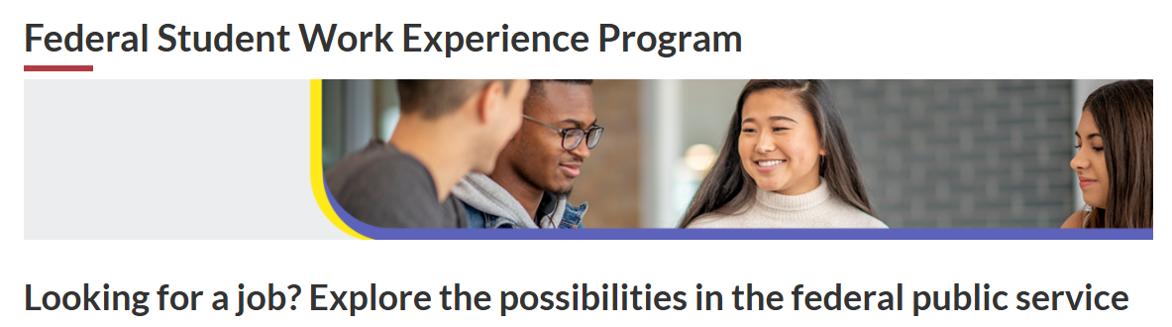
FSWEP (Federal Student Work Experience Program)
Create GC Jobs account to apply
International students are eligible too!
Always select the maximum number of options for each question (area of study, type of work, work location)
Tidy formatting in copy+pasted resume
Pay close attention to deadlines in emails during job processes – responses are often required within 12 – 24 hours of being notified
FSWEP is an inventory – this means your application is entered into a general “reservoir” of applicants, and is sent to hiring managers to review based on how much you match their desired hiring criteria.

Slide 19
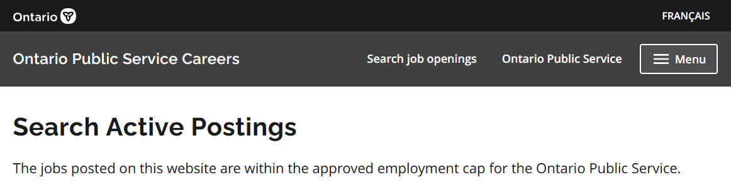
Ontario Public Service Careers
No account required
Under ‘Job Category’, select area of study and ‘Internships’ and ‘Student Summer Employment Opportunities’ (if work term is in the Summer 2025 semester)
Co-op jobs are often posted directly with the Co-op and Career Centre
Consider applying through the Diverse Talent Stream (if you meet the requirements) to have your application considered in multiple hiring streams
https://www.gojobs.gov.on.ca/Search.aspx

Slide 20
City of Ottawa
Demonstrate that you meet all Education and Experience job requirements
Answer all screening questions – used to screen out unqualified candidates
Language requirements: All positions require strong English skills, some positions are bilingual (French/English)
Make language competency clear in your application
Complete your candidate profile and attach your proof of enrollment
Complete the optional self-ID questionnaire – managers are asked to refer to questionnaire when making hiring decisions
All applications are screened by staffing officers, then passed on to hiring managers

Slide 21
Other Job Boards / Resources
Notes:
Overlap with ‘Job Search Outside HireAC’ job search term workshop

Slide 22

Book of Lists – obj.ca/BOL

Slide 23
Online Job Boards
General
Industry-Specific
TIP
Check out company websites to see if they have jobs posted that are not advertised on online job boards
Charity Village
Glassdoor
Canada's Top 100 Employers
Monster.ca
Technata
Goodwork
Hcareers
Engineering Careers

